Slide 1
ÉCOLE POLYTECHNIQUE
INF 421 Project
Drawing Contest
Kunhao ZHENG & Yuyang ZHAO

Slide 2
Plan
I. Introduction of objectives
II. Algorithms and implementation
III. Analysis of performance

Slide 3
Objectives
Principal Objective:
Computation of upward drawings of directed acyclic graphs on an integer grid
Sub-objectives:
Check the validity of a drawing
Compute the number of crossing
Compute a valid drawing
Minimize the number of drawings

Slide 4
Algorithms
Check the validity of a drawing
Relationship of y-coordinates of each edge
Vertices on another edge
Integer in the grids
Compute the number of crossings

Slide 5
Algorithms
Compute a valid drawing
Topological order with DFS
Compute the maximum y-cooridinates of predecessors
Testify the validity

Slide 6
Algorithms
Force-directed Layouts
Calculate the force received by each node.
Move the node in the direction of the force each round.
Repeat until all the forces are in balance.
Notes:
I’m going to introduce the force-directed algorithm. The idea is very clear here.
We regard the nodes in the graph as the particles and the edges as the chemical bonds.
So we can calculate the force among the particles. What we want is a force-balanced status, where the total force is zero. We move all the nodes in the direction of the force each time. And we repeat the procedure until all the forces are in balance.

Slide 7

How can we calculate the force?
Force-directed Layouts
Spring embedding model:
We also add:
repulsive force between edges which share the same endpoint
Notes:
Here we go deeper into the technical details. How can we calculate the force? Given the spring embedding model, we assume that between the nodes which are linked by a edge, there is an attractive force. Also, among all the nodes, there exists a repulsive force, avoiding the nodes crash together.
Based on it, we add the repulsive force as well between two edges which share the same endpoint, making the node stretch all the branches as far as possible,

Slide 8




How can we calculate the force?
Repulsive force between edges
We want the force:
Positive with the length of the edges
Negative with the angle between edges
In horizontal direction
Notes:
The repulsive force between two edges has the property below:
We want it positive with the length of the edges. The longer the edges, the stronger the force. That’s the reason why we choose arctan.
And also negative with the angle between edges, which means small angle equals big force. To simplify, also to keep the valid upward drawing, we only make the force effects in horizontal direction.
So the final expression looks like this.

Slide 9
Challenge
How to keep the drawing valid when adjusting position?
Only adjust the position in horizontal direction (×)
Adjust all the nodes above(resp. below) in the same direction (√)
To finally fit in the canvas, we do the dilatation transformation
(works well in big canvas)
Notes:
How can we keep the drawing valid when adjusting position? Instead of only adjusting the position in horizontal direction, we keep following the original direction. However, while adjusting a single node, we adjust also all the nodes above or below, depending on the force, in the same direction.
But that will cause a problem, it may be possible that in the end, the graph is out of range, which is not valid.
To fix that, we decide to do a dilatation transformation, making it finally fit in the canvas. This works quite well in big canvas input.

Slide 10
Algorithms
Local search heuristic
Compute the edges that most contribute to the number of crossings.
Move both of its endpoints in a certain search range.
Adjust the position while maintaining a valid upward drawing.
Repeat until we can do no more to reduce the number of crossings.
Notes:
Now I’m going to move forward to the local search heuristic.
Compute the edges that most contribute to the number of crossings.
Move both of its endpoints in a certain search range.
Adjust the position while maintaining a valid upward drawing.
Repeat until we can do no more to reduce the number of crossings.

Slide 11
Details
How to find “the edges that most contribute to the number of crossings”?
We add a new class NodeSegment to represent edges in the graph.
Thus we can add numberOfCrossings in the class for each edge.
We put the edges into a priority queue by numberOfCrossings.
The first edge out is which has the most crossings with others.
Notes:
As always, we go into the details. The first question is How to find the edges that most contribute to the number of crossings?
We are given the class Node. Initially we store only the predecessors and successors of each node. Certainly, beginning from Node is possible. But it’s also somehow disturbing, for the reason that each time we want an edge, we must pass through the node.
So we add a new class NodeSegment, to represent edges in the graph. Also, we can construct several useful field in the class, such as the numberOfCrossings of this edges. Or all the edges who share the same endpoint or startpoint, things like that.
After constructing the segment and initialization, we put the edges into a priority queue by numberOfCrossings.
The first edge out of the queue is which has the most crossings with others.
In the same way, we can find the second edges which contribute most to the number of crossing and so on.

Slide 12
Details
How to determine the search range?
The search range is given by 4 bounds which form a rectangle:
upperbound = Min{ Min{sucessors.getY()}-1,this.getY()+range, height}
lowerbound = Max{ Max{predecessors.getY()}+1,this.getY()-range, 0}
rightbound = Min{this.getX()+range, width}
leftbound = Max{this.getX()-range, 0}
Notes:
How to determine the search range of the endpoints?
First, we pass in a parameter range. But the real search range is not that simple.
Basically, the upperbound is the minimum among the three quantities, the first one is to limit the search range under all the successors, keeping the upward property. The third one is to limit it into the canvas. The others is the similar expression as this one.

Slide 13
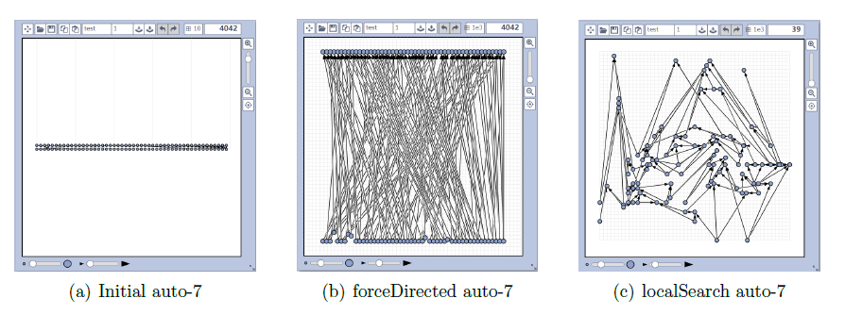
Performance
Force-directed layouts v.s. Local search heuristic

Slide 14
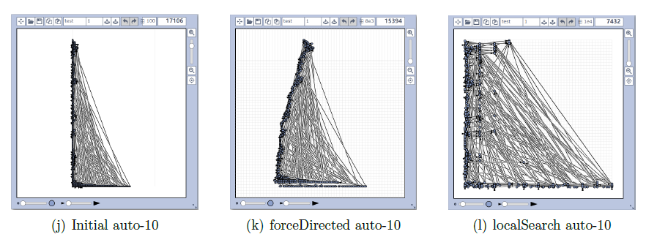
Performance
Force-directed layouts v.s. Local search heuristic

Slide 15
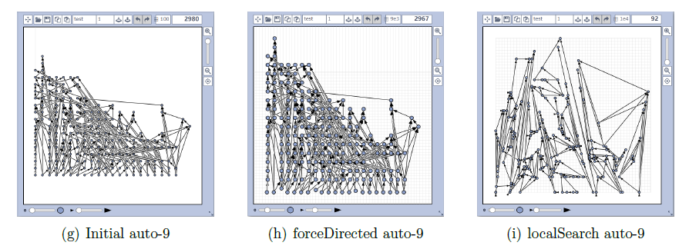
Performance
Force-directed layouts v.s. Local search heuristic

Slide 16
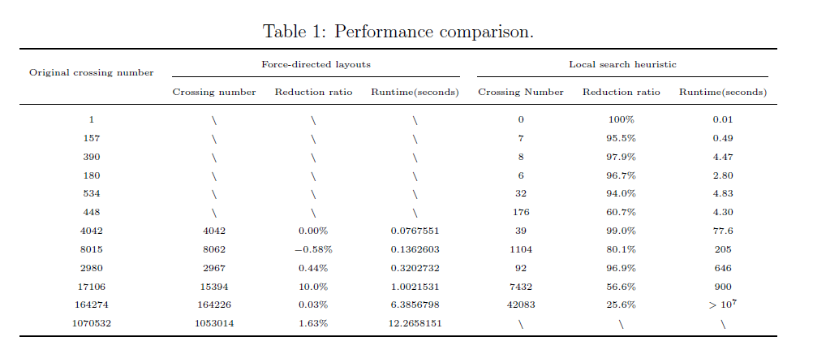
Performance
Force-directed layouts v.s. Local search heuristic
$${>10}^{5}$$

Slide 17
ÉCOLE POLYTECHNIQUE
Thanks for your attention
Kunhao ZHENG & Yuyang ZHAO

